Slide 1
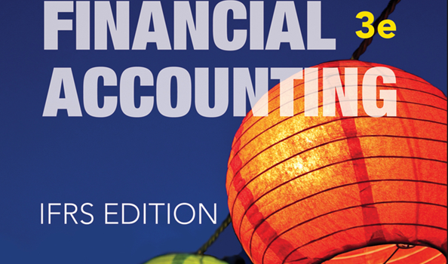
WILEY
IFRS EDITION
Prepared by
Coby Harmon
University of California, Santa Barbara
Westmont College

Slide 2
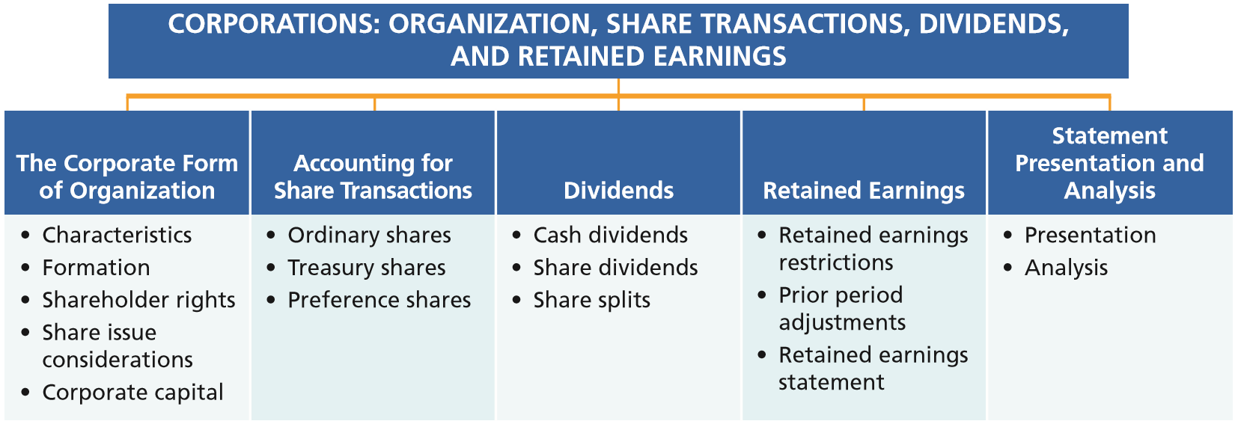
PREVIEW OF CHAPTER 11
Financial Accounting
IFRS 3rd Edition
Weygandt ● Kimmel ● Kieso

Slide 3
CHAPTER
Corporations: Organization, Share Transactions, Dividends, and Retained Earnings
11
LEARNING OBJECTIVES
After studying this chapter, you should be able to:
Identify the major characteristics of a corporation.
Record the issuance of ordinary shares.
Explain the accounting for treasury shares.
Differentiate preference shares from ordinary shares.
Prepare the entries for cash dividends and share dividends.
Identify the items reported in a retained earnings statement.
Prepare and analyze a comprehensive equity section.

Slide 4
The Corporate Form of Organization
Learning Objective 1
Identify the major characteristics of a corporation.
An entity separate and distinct
from its owners.
Classified by Purpose
Not-for-Profit
For Profit
Classified by Ownership
Publicly held
Privately held
Salvation Army (USA)
International Committee of the Red Cross (CHE)
Toyota (JPN)
Siemens (DEU)
Sinopec (CHN)
General Electric (USA)
Cargill Inc. (USA)
LO 1

Slide 5
Characteristics of a Corporation
Characteristics that distinguish corporations from proprietorships and partnerships.
Separate Legal Existence
Limited Liability of Shareholders
Transferable Ownership Rights
Ability to Acquire Capital
Continuous Life
Corporate Management
Government Regulations
Additional Taxes
Advantages
Disadvantages
LO 1

Slide 6
Characteristics of a Corporation
Characteristics that distinguish corporations from proprietorships and partnerships.
Corporation acts under its own name rather than in the name of its shareholders.
Separate Legal Existence
Limited Liability of Shareholders
Transferable Ownership Rights
Ability to Acquire Capital
Continuous Life
Corporate Management
Government Regulations
Additional Taxes
LO 1

Slide 7
Characteristics of a Corporation
Characteristics that distinguish corporations from proprietorships and partnerships.
Separate Legal Existence
Limited Liability of Shareholders
Transferable Ownership Rights
Ability to Acquire Capital
Continuous Life
Corporate Management
Government Regulations
Additional Taxes
Limited to their investment.
LO 1

Slide 8
Characteristics of a Corporation
Characteristics that distinguish corporations from proprietorships and partnerships.
Separate Legal Existence
Limited Liability of Shareholders
Transferable Ownership Rights
Ability to Acquire Capital
Continuous Life
Corporate Management
Government Regulations
Additional Taxes
Shareholders may sell their shares.
LO 1

Slide 9
Characteristics of a Corporation
Characteristics that distinguish corporations from proprietorships and partnerships.
Separate Legal Existence
Limited Liability of Shareholders
Transferable Ownership Rights
Ability to Acquire Capital
Continuous Life
Corporate Management
Government Regulations
Additional Taxes
Corporation can obtain capital through the issuance of shares.
LO 1

Slide 10
Characteristics of a Corporation
Characteristics that distinguish corporations from proprietorships and partnerships.
Separate Legal Existence
Limited Liability of Shareholders
Transferable Ownership Rights
Ability to Acquire Capital
Continuous Life
Corporate Management
Government Regulations
Additional Taxes
Continuance as a going concern is not affected by the withdrawal, death, or incapacity of a shareholder, employee, or officer.
LO 1

Slide 11
Characteristics of a Corporation
Characteristics that distinguish corporations from proprietorships and partnerships.
Separate Legal Existence
Limited Liability of Shareholders
Transferable Ownership Rights
Ability to Acquire Capital
Continuous Life
Corporate Management
Government Regulations
Additional Taxes
Separation of ownership and management prevents owners from having an active role in managing the company.
LO 1

Slide 12
Characteristics of a Corporation
Characteristics that distinguish corporations from proprietorships and partnerships.
Separate Legal Existence
Limited Liability of Shareholders
Transferable Ownership Rights
Ability to Acquire Capital
Continuous Life
Corporate Management
Government Regulations
Additional Taxes
Government regulations are designed to protect the owners of the corporation.
LO 1

Slide 13
Characteristics of a Corporation
Characteristics that distinguish corporations from proprietorships and partnerships.
Separate Legal Existence
Limited Liability of Shareholders
Transferable Ownership Rights
Ability to Acquire Capital
Continuous Life
Corporate Management
Government Regulations
Additional Taxes
Corporations pay income taxes as a separate legal entity and in addition, shareholders pay taxes on cash dividends.
LO 1

Slide 14
Characteristics of a Corporation
Shareholders
Illustration 11-1
Corporation organization chart
Chairman and
Board of
Directors
President and
Chief Executive
Officer
General
Counsel and
Secretary
Vice President
Marketing
Vice President
Finance/Chief
Financial Officer
Vice President
Operations
Vice President
Human
Resources
Treasurer
Controller
LO 1

Slide 15
Forming a Corporation
Initial Steps:
File application with governmental agency in the jurisdiction in which incorporation is desired.
Government grants charter.
Corporation develops by-laws.
Companies incorporate in a state or country whose laws are favorable to the corporate form of business.
Corporations expense organization costs as incurred.
LO 1

Slide 16
Ownership Rights of Shareholders
Shareholders have the right to:
1. Vote in election of board of directors and on actions that require shareholder approval.
2. Share the corporate earnings through receipt of dividends.
Illustration 11-3
Ownership rights of shareholders
LO 1

Slide 17
Ownership Rights of Shareholders
Shareholders have the right to:
Illustration 11-3
Ownership rights of shareholders
3. Keep the same percentage ownership when new shares are issued (preemptive right*).
* A number of companies have eliminated the preemptive right.
LO 1

Slide 18
Ownership Rights of Shareholders
Shareholders have the right to:
4. Share in assets upon liquidation in proportion to their holdings. This is called a residual claim.
Illustration 11-3
Ownership rights of shareholders
LO 1

Slide 19
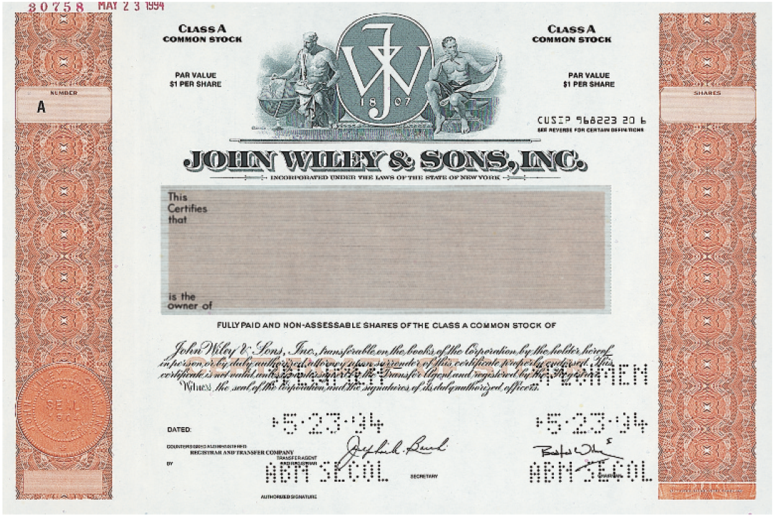
Ownership Rights of Shareholders
Illustration 11-4
A share certificate
Prenumbered
PAR VALUE $1 PER SHARE
PAR VALUE $1 PER SHARE
Name of corporation
Shareholder’s name
Shares
Bill Harmon
Signature of corporate official
LO 1

Slide 20
Share Issue Considerations
AUTHORIZED SHARES
Charter indicates the amount of shares that a corporation is authorized to sell.
Number of authorized shares is often reported in the equity section.
LO 1

Slide 21
Share Issue Considerations
ISSUANCE OF SHARES
Corporation can issue ordinary shares directly to investors or indirectly through an investment banking firm.
Factors in setting price for a new issue of shares:
Company’s anticipated future earnings.
Expected dividend rate per share.
Current financial position.
Current state of the economy.
Current state of the securities market.
LO 1

Slide 22
Share Issue Considerations
MARKET PRICE OF SHARES
Shares of publicly held companies is traded on organized exchanges.
Interaction between buyers and sellers determines the prices per share.
Prices tend to follow the trend of a company’s earnings and dividends.
Factors beyond a company’s control may cause day-to-day fluctuations in market prices.
LO 1

Slide 23
Investor Insight How to Read Share Quotes
Organized exchanges trade the shares of publicly held companies at prices per share established by the interaction between buyers and sellers. For each listed security, the financial press reports the high and low prices of the shares during the year, the total volume of shares traded on a given day, the high and low prices for the day, and the closing market price, with the net change for the day. adidas (DEU) is listed on a number of exchanges. Here is a listing for adidas (prices are in euros).
These numbers indicate the following. The high and low market prices for the previous 52 weeks were €57.62 and €42.41. The trading volume for the day was 1,080,000 shares. The high, low, and closing prices for that date were €52.50, €50.77, and €50.79, respectively. The net change for the day was a decrease of €1.081 per share.
LO 1

Slide 24
Share Issue Considerations
PAR AND NO-PAR VALUE SHARES
Years ago, par value determined the legal capital per share that a company must retain in the business for the protection of corporate creditors.
Today many governments do not require a par value.
No-par value shares are fairly common today.
In many countries the board of directors assigns a stated value to no-par shares.
LO 1

Slide 25
Share Issue Considerations
Question
Which of the following statements is false?
Ownership of ordinary shares gives the owner a voting right.
The equity section begins with a share capital section.
The authorization of share capital does not result in a formal accounting entry.
Par value and market price of a company’s shares are always the same.
LO 1

Slide 26
>
DO IT!
Indicate whether each of the following statements is true or false.
Similar to partners in a partnership, shareholders of a corporation have unlimited liability.
It is relatively easy for a corporation to obtain capital through the issuance of shares.
The separation of ownership and management is an advantage of the corporate form of business.
The journal entry to record the authorization of ordinary shares includes a credit to the appropriate share capital account.
False
True
False
False
LO 1

Slide 27
Corporate Capital
Equity is identified by various names:
stockholders’ equity,
shareholders’ equity, or
corporate capital.
The equity section of a corporation’s statement of financial position consists of two parts:
share capital and
retained earnings (earned capital).
LO 1

Slide 28
Corporate Capital
Illustration 11-5
Equity section
LO 1

Slide 29
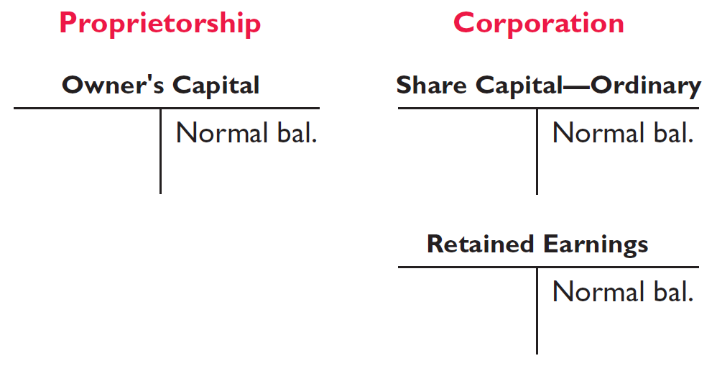
Corporate Capital
Comparison of the equity accounts for a proprietorship, and a corporation.
Illustration 11-6
Comparison of equity accounts
LO 1

Slide 30
People, Planet, and Profit Insight
The Impact of Corporate Social Responsibility
A recent survey conducted by Institutional Shareholder Services, a U.S. proxy advisory firm, shows that 83% of investors now believe environmental and social factors can have a significant impact on shareholder value over the long term. This belief is clearly visible in the rising level of support for shareholder proposals requesting action related to social and environmental issues. The following table shows that the number of corporate social responsibility (CSR)-related shareholder proposals rose from 150 in 2000 to 191 in 2010. Moreover, those proposals garnered average voting support of 18.4% of votes cast versus just 7.5% a decade earlier.
Source: Investor Responsibility Research Center, Ernst & Young, Seven Questions CEOs and Boards Should Ask About: “Triple Bottom Line” Reporting.
LO 1

Slide 31
>
DO IT!
At the end of its first year of operation, Doral AG has €750,000 of ordinary share and net income of €122,000. Prepare (a) the closing entry for net income and (b) the equity section at year-end.
(a)
Income Summary 122,000
Retained Earnings 122,000
Equity
Share capital—ordinary €750,000
Retained earnings 122,000
Total equity €872,000
(b)
LO 1

Slide 32
Accounting for Ordinary Share Issues
Learning Objective 2
Record the issuance of ordinary shares.
ISSUING PAR VALUE ORDINARY SHARES FOR CASH
Illustration: Hydro-Slide SA issues 1,000 shares of €1 par value ordinary shares. Prepare Hydro-Slide’s journal entry if (a) 1,000 shares are issued for €1 per share, and (b) 1,000 shares are issued for €5 per share.
a)
Cash 1,000
Share Capital—Ordinary (1,000 x €1) 1,000
b)
Cash 5,000
Share Capital—Ordinary (1,000 x €1) 1,000
Share Premium—Ordinary 4,000
LO 2

Slide 33
PAR VALUE ORDINARY SHARES
Illustration 11-7
Share premium
LO 2

Slide 34
Accounting for Ordinary Share Issues
ISSUING NO-PAR ORDINARY SHARES FOR CASH
Illustration: Assume that Hydro-Slide SA issues 5,000 shares of €5 stated value no-par shares for €8 per share. The entry is:
Cash 40,000
Share Capital—Ordinary (5,000 x €5) 25,000
Share Premium—Ordinary 15,000
Prepare the entry assuming there is no stated value.
Cash 40,000
Share Capital—Ordinary 40,000
LO 2

Slide 35
Accounting for Ordinary Share Issues
ISSUING ORDINARY SHARES FOR SERVICES OR NON-CASH ASSETS
Corporations also may issue shares for:
Services (attorneys or consultants).
Noncash assets (land, buildings, and equipment).
Cost is either the fair market value of the consideration given up, or the fair market value of the consideration received, whichever is more clearly determinable.
LO 2

Slide 36
ISSUING ORDINARY SHARES FOR SERVICES OR NON-CASH ASSETS
Illustration: Assume that attorneys have helped Jordan Company incorporate. They have billed the company €5,000 for their services. They agree to accept 4,000 shares of €1 par value shares in payment of their bill. At the time of the exchange, there is no established market price for the shares. Prepare the journal entry for this transaction.
Organization Expense 5,000
Share Capital—Ordinary 4,000
Share Premium—Ordinary 1,000
LO 2

Slide 37
ISSUING ORDINARY SHARES FOR SERVICES OR NON-CASH ASSETS
Illustration: Assume that Athletic Research Inc. is an existing publicly held corporation. Its €5 par value shares are actively traded at €8 per share. The company issues 10,000 shares to acquire land recently advertised for sale at €90,000. Prepare the journal entry for this transaction.
Land 80,000
Share Capital—Ordinary 50,000
Share Premium—Ordinary 30,000
LO 2

Slide 38
ANATOMY OF A FRAUD
The president, chief operating officer, and chief financial officer of SafeNet (USA), a software encryption company, were each awarded employee share options by the company’s board of directors as part of their compensation package. Share options enable an employee to buy a company’s shares sometime in the future at the price that existed when the share option was awarded. For example, suppose that you received share options today, when the share price of your company was $30. Three years later, if the share price rose to $100, you could “exercise” your options and buy the shares for $30 per share, thereby making $70 per share. After being awarded their share options, the three employees changed the award dates in the company’s records to dates in the past, when the company’s shares were trading at historical lows. For example, using the previous example, they would choose a past date when the shares were selling for $10 per share, rather than the $30 price on the actual award date. In our example, this would increase the profit from exercising the options to $90 per share.
Total take: $1.7 million
The Missing Control
Independent internal verification. The company’s board of directors should have ensured that the awards were properly administered. For example, the date on the minutes from the board meeting could be compared to the dates that were recorded for the awards. In addition, the dates should again be confirmed upon exercise.
LO 2

Slide 39
>
DO IT!
Hefei Ltd. begins operations on March 1 by issuing 1,000,000 ¥10 par value ordinary shares for cash at ¥12 per share. On March 15, it issues 50,000 ordinary shares to attorneys in settlement of their bill of ¥600,000 for organization costs. Journalize the issuance of the shares, assuming the shares are not publicly traded.
Mar. 1
Cash 12,000,000
Share Capital—Ordinary 10,000,000
Share Premium—Ordinary 2,000,000
Mar. 15
Organization Expense 600,000
Share Capital—Ordinary 500,000
Share Premium—Ordinary 100,000
LO 2

Slide 40
Accounting for Treasury Shares
Learning Objective 3
Explain the accounting for treasury shares.
Treasury shares are a corporation’s own shares that it has reacquired from shareholders but not retired.
Corporations purchase their outstanding shares to:
Reissue the shares to officers and employees under bonus and share compensation plans.
Enhance the share’s market value.
Have additional shares available for use in the acquisition of other companies.
Increase earnings per share.
Eliminate hostile shareholders by buying them out.
LO 3

Slide 41
Accounting for Treasury Shares
PURCHASE OF TREASURY SHARES
Debit Treasury Shares for the price paid to reacquire the shares (cost method).
Treasury Shares is a contra equity account, not an asset.
Purchase of treasury shares reduces equity.
LO 3

Slide 42
Accounting for Treasury Shares
Illustration 11-8
Equity section with no treasury shares
Illustration: On February 1, 2017, Mead acquires 4,000 shares of its stock at HK$80 per share.
Treasury Shares (4,000 x HK$80) 320,000
Cash 320,000
LO 3

Slide 43
Accounting for Treasury Shares
Equity Section with Treasury Shares
Illustration 11-9
Both the number of shares issued (100,000), outstanding (96,000), and the number of shares held as treasury (4,000) are disclosed.
LO 3

Slide 44
Accounting for Treasury Shares
Question
In the statement of financial position, the cost of treasury shares is deducted in:
expenses.
revenues.
equity.
liabilities.
LO 3

Slide 45
Accounting Across the Organization
Why Would a Company Buy Its Own Shares?
In a bold (and some would say risky) move, Reebok (DEU) at one time bought back nearly a third of its shares. This repurchase of shares dramatically reduced Reebok’s available cash. In fact, the company borrowed significant funds to accomplish the repurchase. In a press release, management stated that it was repurchasing the shares because it believed its shares were severely underpriced. The repurchase of so many shares was meant to signal management’s belief in good future earnings. Skeptics, however, suggested that Reebok’s management was repurchasing shares to make it less likely that another company would acquire Reebok (in which case Reebok’s top managers would likely lose their jobs). By depleting its cash, Reebok became a less likely acquisition target. Acquiring companies like to purchase companies with large cash balances so they can pay off debt used in the acquisition. As noted in the Feature Story, Reebok was eventually acquired by adidas (DEU). In 2014, adidas announced a program to buy back up to 10% of its shares. This was done to appease shareholders who were disappointed with the company’s results in recent years.
LO 3

Slide 46
Accounting for Treasury Shares
DISPOSAL OF TREASURY SHARES
Sale of Treasury Shares
Above Cost
Below Cost
Both increase total assets and equity.
LO 3

Slide 47
Accounting for Treasury Shares
Above Cost
Illustration: On July 1, Mead sells for HK$100 per share 1,000 shares of its treasury shares, previously acquired at HK$80 per share.
July 1
Cash 100,000
Treasury Shares (1,000 x HK$80) 80,000
Share Premium—Treasury 20,000
A corporation does not realize a gain or suffer a loss from share transactions with its own shareholders.
LO 3

Slide 48
Accounting for Treasury Shares
Below Cost
Illustration: On Oct. 1, Mead sells an additional 800 treasury shares at HK$70 per share.
Oct. 1
Cash 56,000
Share Premium—Treasury 8,000
Treasury Shares (800 x HK$80) 64,000
Illustration 11-10
LO 3

Slide 49
Accounting for Treasury Shares
Below Cost
Illustration: On Dec. 1, assume that Mead, Inc. sells its remaining 2,200 shares at HK$70 per share.
Dec. 1
Cash 154,000
Limited to balance on hand
Share Premium—Treasury 12,000
Retained Earnings 10,000
Treasury Shares 176,000
LO 3

Slide 50
>
DO IT!
Salvador SA purchases 3,000 shares of its R$50 par value ordinary shares for R$180,000 cash on July 1. It will hold the shares in the treasury until resold. On November 1, the corporation sells 1,000 treasury shares for cash at R$70 per share. Journalize the treasury share transactions.
July 1
Treasury Shares 180,000
Cash 180,000
Nov. 1
Cash 70,000
Treasury Shares 60,000
Share Premium—Treasury 10,000
LO 3

Slide 51
Accounting for Preference Shares
Learning Objective 4
Differentiate preference shares from ordinary shares.
Typically, preference shareholders have
a priority as to
distributions of earnings (dividends) and
assets in the event of liquidation.
Accounting for preference shares at issuance is similar to that for ordinary shares.
LO 4

Slide 52
Accounting for Preference Shares
Illustration: Stine Corporation issues 10,000 shares of €10 par value preference shares for €12 cash per share. Journalize the issuance of the preference shares.
Cash 120,000
Share Capital—Preference (10,000 x €10) 100,000
Share Premium—Preference 20,000
Preference shares may have a par value or no-par value.
LO 4

Slide 53
Accounting for Preference Shares
DIVIDEND PREFERENCES
Right to receive dividends before ordinary shareholders.
Cumulative Dividend – preference shareholders must be paid both current-year dividends and any unpaid prior-year dividends before ordinary shareholders receive dividends.
No obligation exists until board of directors declares a dividend.
Liquidation preference.
LO 4

Slide 54
Accounting for Preference Shares
CUMULATIVE DIVIDEND
Illustration: Scientific Leasing has 5,000 shares of 7%, €100 par value, cumulative preference shares outstanding. Each €100 share pays a €7 dividend (.07 x €100). The annual dividend is €35,000 (5,000 x €7 per share). If dividends are two years in arrears, preference shareholders are entitled to receive the following dividends in the current year.
Illustration 11-11
Computation of total dividends to preference shares
LO 4

Slide 55
Accounting for Preference Shares
LIQUIDATION PREFERENCES
Most preference shares have a preference on corporate assets if the corporation fails.
Provides security for the preference shareholder.
Preference to assets may be for the par value of the shares or for a specified liquidating value.
LO 4

Slide 56
The Corporate Form of Organization
Learning Objective 5
Prepare the entries for cash dividends and share dividends.
Distribution of cash or shares to shareholders on a pro rata (proportional) basis.
Types of Dividends:
Cash
Property
Shares
Scrip
Dividends expressed: (1) as a percentage of the par or stated value, or (2) as a dollar amount per share.
LO 5

Slide 57
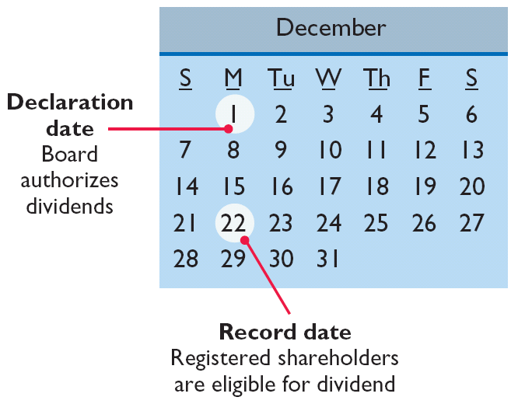
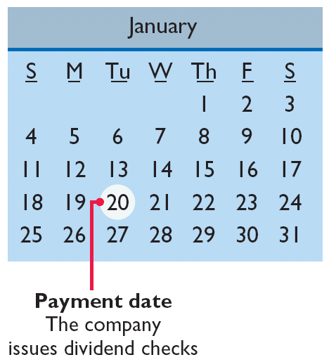
Cash Dividends
Three dates:
Illustration 11-12
Key dividend dates
LO 5

Slide 58
Cash Dividends
For a corporation to pay a cash dividend, it must have:
Retained earnings - Payment of cash dividends from retained earnings is legal in all jurisdictions.
Adequate cash.
A declaration of dividends by the Board of Directors.
LO 5

Slide 59
ENTRIES FOR CASH DIVIDENDS
Illustration: On Dec. 1, the directors of Media General declare a €.50 per share cash dividend on 100,000 shares of €10 par value ordinary shares. The dividend is payable on Jan. 20 to shareholders of record on Dec. 22.
December 1 (Declaration Date)
Cash Dividends 50,000
Dividends Payable 50,000
December 22 (Date of Record)
No entry
January 20 (Payment Date)
Dividends Payable 50,000
Cash 50,000
LO 5

Slide 60
Cash Dividends
ALLOCATING CASH DIVIDENDS BETWEEN PREFERENCE AND ORDINARY SHARES
Holders of cumulative preference shares must be paid any unpaid prior-year dividends before ordinary shareholders receive dividends.
LO 5

Slide 61
Cash Dividends
Illustration: On December 31, 2017, IBR Inc. has 1,000 shares of 8%, €100 par value cumulative preference shares. It also has 50,000 shares of €10 par value ordinary shares outstanding. At December 31, 2017, the directors declare a €6,000 cash dividend. Prepare the entry to record the declaration of the dividend.
Cash Dividends 6,000
Dividends Payable 6,000
Preference Dividends: 1,000 shares x €100 par x 8% = €8,000
LO 5

Slide 62
Cash Dividends
Illustration: At December 31, 2018, IBR declares a €50,000 cash dividend. The allocation of the dividend to the two classes of shares is as follows:
Illustration 11-13
Allocating dividends to preference and ordinary shares
LO 5

Slide 63
Cash Dividends
Illustration: At December 31, 2018, IBR declares a €50,000 cash dividend. Prepare the entry to record the declaration of the dividend.
Cash Dividends 50,000
Dividends Payable 50,000
LO 5

Slide 64
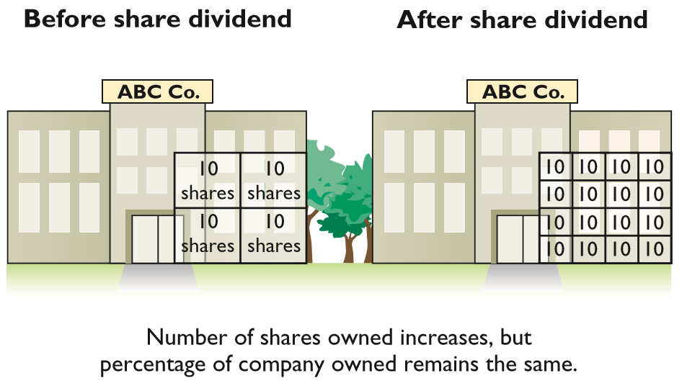
Share Dividends
Pro rata distribution of the corporation’s own shares.
Illustration 11-14
Effect of stock split for shareholders
Results in decrease in retained earnings and increase share capital and share premium.
LO 5

Slide 65
Share Dividends
Reasons why corporations issue share dividends:
Satisfy shareholders’ dividend expectations without spending cash.
Increase marketability of the corporation’s shares.
Emphasize a portion of equity has been permanently reinvested in the business.
LO 5

Slide 66
Share Dividends
Small share dividend (less than 20–25% of the corporation’s issued shares, recorded at fair market value) *
Large share dividend (greater than 20–25% of issued shares, recorded at par value)
* Accounting based on the assumption that a small share dividend will have little effect on the market price of the outstanding shares.
LO 5

Slide 67
Share Dividends
Illustration: Danshui Ltd. has a balance of NT$3,000,000 in retained earnings. It declares a 10% share dividend on its 50,000 shares of NT$100 par value ordinary shares. The current fair market value of its shares is NT$150 per share.
10% share dividend is declared
Share Dividends (50,000 x 10% x NT$150)
750,000
Ordinary Share Dividends Distributable
500,000
Share Premium—Ordinary
250,000
Shares issued
Ordinary Share Dividends Distributable
500,000
Share Capital—Ordinary (50,000 x 10% x NT$100)
500,000
LO 5

Slide 68
Share Dividends
Statement Presentation
Illustration 11-15
Statement presentation of ordinary shares dividends distributable
LO 5

Slide 69
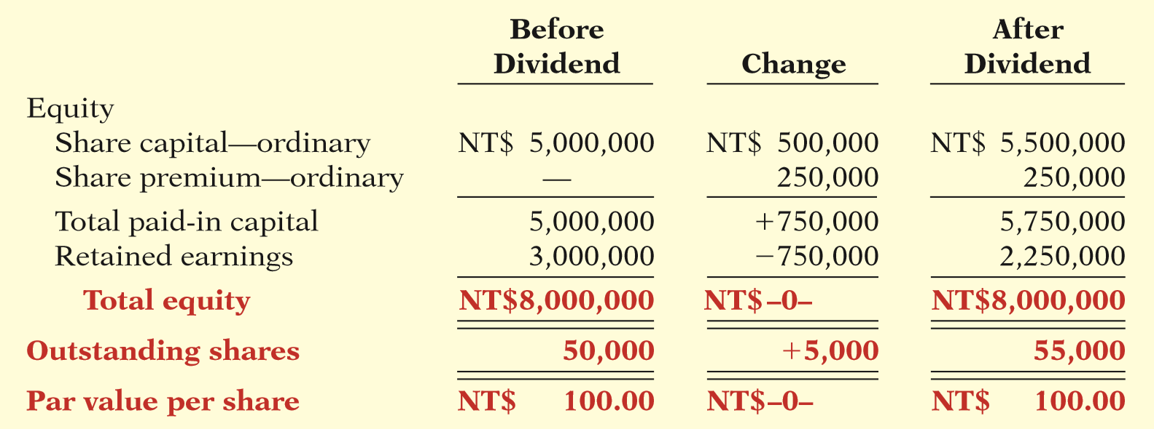
Share Dividends
EFFECTS OF SHARE DIVIDENDS
Illustration 11-16
Share dividend effects
LO 5

Slide 70
Share Dividends
Question
Which of the following statements about small share dividends is true?
A debit to Retained Earnings for the par value of the shares issued should be made.
A small share dividend decreases total equity.
Market price per share should be assigned to the dividend shares.
A small share dividend ordinarily will have an effect on par value per share.
LO 5

Slide 71
Share Splits
Reduces the market value of shares.
No entry recorded for a share split.
Decrease par value and increase number of shares.
LO 5

Slide 72
Share Splits
Illustration: Assume Danshui Ltd. splits its 50,000 ordinary shares on a 2-for-1 basis.
Illustration 11-17
Share split effects
Results in a reduction of the par or stated value per share.
LO 5

Slide 73
Investor Insight
A No-Split Philosophy
Warren Buffett’s company, Berkshire Hathaway (USA), has two classes of shares. Until recently, the company had never split either class of shares. As a result, the class A shares had a market price of $97,000 and the class B sold for about $3,200 per share. Because the price per share is so high, the shares do not trade as frequently as the shares of other companies. Mr. Buffett has always opposed share splits because he feels that a lower share price attracts short-term investors. He appears to be correct. For example, while more than 6 million shares of IBM (USA) are exchanged on the average day, only about 1,000 class A shares of Berkshire are traded. Despite Mr. Buffett’s aversion to splits, in order to accomplish a recent acquisition, Berkshire decided to split its class B shares 50 to 1.
Source: Scott Patterson, “Berkshire Nears Smaller Baby B’s,” Wall Street Journal Online (January 19, 2010).
LO 5

Slide 74
>
DO IT!
The market price of Sing CD Company’s 500,000 shares of £2 par value ordinary shares is £45. President Joan Elbert is considering either a 10% share dividend or a 2-for-1 share split. She asks you to show the before-and-after effects of each option on retained earnings, total equity, total shares outstanding, and par value per share.
Share dividend amount is £2,250,000 [(500,000 × 10%) × £45].
LO 5

Slide 75
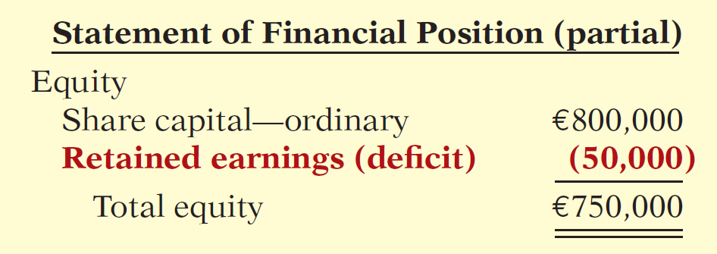
Retained Earnings
Learning Objective 6
Identify the items reported in a retained earnings statement.
Net income increases Retained
Earnings and a net loss decreases
Retained Earnings.
Part of the shareholders’ claim on the total assets of the corporation.
Debit balance in Retained Earnings is identified as a deficit.
Illustration 11-20
Equity with deficit
LO 6

Slide 76
Retained Earnings Restrictions
Restrictions can result from:
Legal restrictions.
Contractual restrictions.
Voluntary restrictions.
Companies generally disclose retained earnings restrictions in the notes to the financial statements.
LO 6

Slide 77
Prior Period Adjustments
Correction of an error in previously issued financial statements.
Result from:
mathematical mistakes.
mistakes in application of accounting principles.
oversight or misuse of facts.
Adjustment made to the beginning balance of retained earnings.
LO 6

Slide 78
>
DO IT!
Chen Ltd. has retained earnings of ¥5,130,000 on January 1, 2017. During the year, Chen earned ¥2,000,000 of net income. It declared and paid a ¥250,000 cash dividend. In 2017, Chen recorded an adjustment of ¥180,000 due to the understatement (from a mathematical error) of 2016 depreciation expense. Prepare a corrected retained earnings statement for 2017.
LO 6

Slide 79
>
DO IT!
In 2017, Chen recorded an adjustment of ¥180,000 due to the understatement (from a mathematical error) of 2016 depreciation expense. Prepare a retained earnings statement for 2017.
LO 6

Slide 80
Retained Earnings Statement
Debits and Credits to Retained Earnings
Illustration 11-23
Debits and credits to retained earnings
LO 6

Slide 81
Retained Earnings Statement
Question
All but one of the following is reported in a retained earnings statement. The exception is:
cash and share dividends.
net income and net loss.
sales revenue.
prior period adjustments.
LO 6

Slide 82
Statement Presentation and Analysis
Learning Objective 7
Prepare and analyze a comprehensive equity section.
Presentation
Illustration 11-25
Comprehensive equity section
LO 7

Slide 83
Statement Presentation and Analysis
Analysis
Carrefour’s beginning-of-the-year and end-of-the-year ordinary shareholders’ equity were €8,047 and €8,597 million, respectively. Its net income was €1,263 million, and no preference shares were outstanding. The return on ordinary shareholders’ equity is computed as follows.
Illustration 11-27
Return on ordinary shareholders’ equity and computation
LO 7

Slide 84
>
DO IT!
On January 1, 2017, Busan Ltd. purchased 2,000,000 treasury shares. Other information regarding Busan is provided. (All amounts in thousands.)
2016 2017
Net income ₩110,000 ₩110,000
Dividends on preference shares ₩10,000 ₩10,000
Dividends on ordinary shares ₩2,000 ₩1,600
Ordinary shareholders’ equity, beginning of year ₩500,000 ₩400,000*
Ordinary shareholders’ equity, end of year ₩500,000 ₩400,000
*Adjusted for purchase of treasury shares.
Compute return on ordinary shareholders’ equity for each year.
LO 7

Slide 85
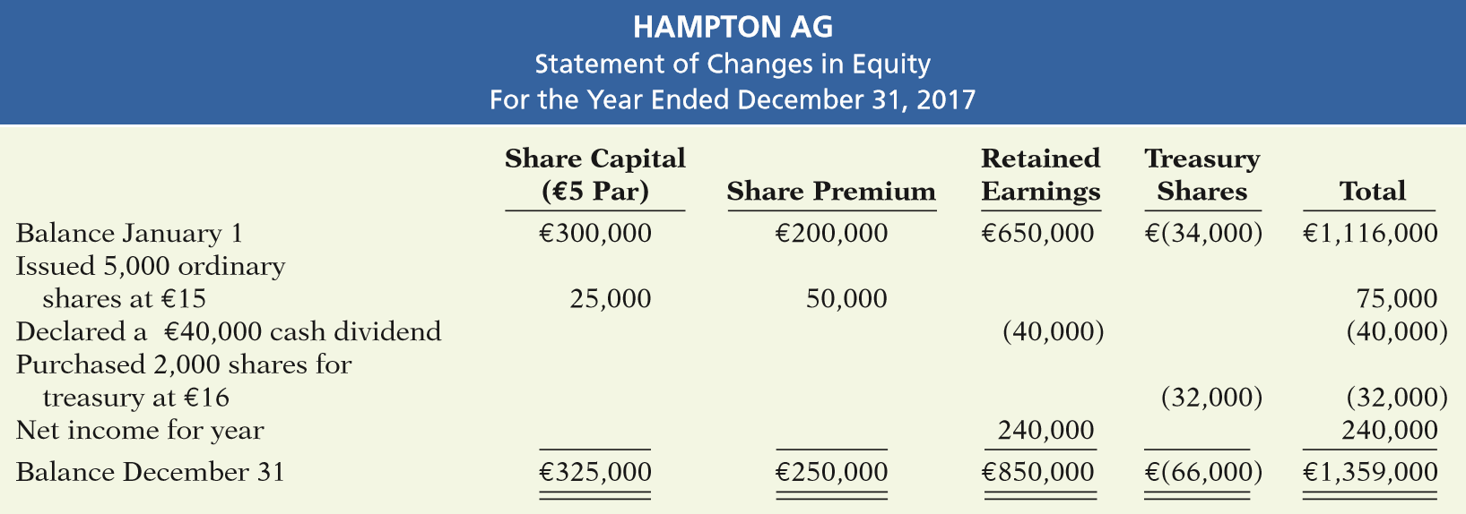
APPENDIX 11A
Statement of Changes in Equity
Learning Objective 8
Describe the use and content of the statement of changes in equity.
Illustration 11A-1
Statement of changes in equity
When a statement of changes in equity is presented, a retained earnings statement is not necessary.
LO 8

Slide 86
APPENDIX 11B
Book Value—Another per Share Amount
Learning Objective 9
Compute book value per share.
Book Value per Share
The equity an ordinary shareholder has in the net assets of the corporation.
Illustration 11B-1
Book value per share formula
LO 9

Slide 87
Book Value per Share
The computation of book value per share involves the following steps.
Compute the preference share equity. This equity is equal to the sum of the call price of preference shares plus any cumulative dividends in arrears. If the preference shares do not have a call price, the par value of the shares is used.
Determine the ordinary shareholders’ equity. Subtract the preference share equity from total equity.
Determine book value per share. Divide ordinary shareholders’ equity by ordinary shares.
LO 9

Slide 88
Book Value per Share
EXAMPLE
Illustration: Using the equity section of Graber SA shown in Illustration 11-25. Graber’s preference shares are callable at €120 per share and are cumulative. Assume that dividends on Graber’s preference shares were in arrears for one year, €54,000 (6,000 x €9). The computation of preference share equity (Step 1 in the preceding list) is:
Illustration 11B-2
Computation of preference share equity—Step 1
LO 9

Slide 89
Book Value per Share
Illustration 11B-2
Computation of book value:
Illustration 11B-3
Computation of book value per share with preference shares— Steps 2 and 3
LO 9

Slide 90
Book Value versus Market Value
The correlation between book value and the annual range of a company’s market value per share is often remote.
Illustration 11B-4
Book value and market price compared
LO 9

Slide 91
A Look at U.S. GAAP
Learning Objective 10
Compare the accounting for equity under IFRS and U.S. GAAP.
Key Points
Many countries have a different mix of investor groups than in the United States. For example, in Germany, financial institutions like banks are not only major creditors of corporations but often are the largest corporate shareholders as well. In the United States, Asia, and the United Kingdom, many companies rely on substantial investment from private investors.
There are often terminology differences for equity accounts.
LO 10

Slide 92
A Look at U.S. GAAP
Key Points
Equity is given various descriptions under IFRS, such as shareholders’ equity, owners’ equity, capital and reserves, and shareholders’ funds.
Similarities
The accounting related to prior period adjustment is essentially the same under IFRS and GAAP. IFRS addresses the accounting for errors in IAS 8 (“Accounting Policies, Changes in Accounting Estimates, and Errors”). One area where IFRS and GAAP differ in reporting relates to error corrections in previously issued financial statements. While IFRS requires restatement with some exceptions, GAAP does not permit any exceptions.
LO 10

Slide 93
A Look at U.S. GAAP
Key Points
Similarities
The income statement using IFRS and GAAP is presented in a one- or two-statement format. The single-statement approach includes all items of income and expense, as well as each component of other comprehensive income or loss by its individual characteristic. In the two-statement approach, a traditional income statement is prepared. It is then followed by a statement of comprehensive income, which starts with net income or loss and then adds other comprehensive income or loss items. Regardless of which approach is reported, income tax expense is required to be reported.
The computations related to earnings per share are essentially the same under IFRS and GAAP.
LO 10

Slide 94
A Look at U.S. GAAP
Key Points
Differences
As indicated in the chapter, under IFRS, the term reserves is used to describe all equity accounts other than those arising from contributed (paid-in) capital. This would include, for example, reserves related to retained earnings, asset revaluations, and fair value differences.
GAAP has always discouraged the use of the term “Reserves” in any context. Under GAAP, comprehensive income items are reported in the equity section of the statement of financial position in a line labeled accumulated other comprehensive income.
LO 10

Slide 95
A Look at U.S. GAAP
Key Points
Differences
The accounting for treasury shares differs somewhat between IFRS and GAAP. However, many of the differences are beyond the scope of this course. Like IFRS, GAAP does not allow a company to record gains or losses on purchases of its own shares. One difference worth noting is that, when a company purchases its own shares, IFRS treats it as a reduction of equity, but it does not specify which particular equity accounts are to be affected. Therefore, it could be shown as an increase to a contra-equity account (Treasury Shares) or a decrease to retained earnings or share capital.
LO 10

Slide 96
A Look at U.S. GAAP
Key Points
Differences
A major difference between IFRS and GAAP relates to the account Revaluation Surplus. Revaluation surplus arises under IFRS because companies are permitted to revalue their property, plant, and equipment to fair value under certain circumstances. This account is part of general reserves under IFRS and is not considered contributed capital. GAAP does not permit revaluation of property, plant, and equipment.
IFRS often uses terms such as retained profits or accumulated profit or loss to describe retained earnings. The term retained earnings is also often used under GAAP.
LO 10

Slide 97
A Look at U.S. GAAP
Looking to the Future
The IASB and the FASB are currently working on a project related to financial statement presentation. An important part of this study is to determine whether certain line items, subtotals, and totals should be clearly defined and required to be displayed in the financial statements. For example, it is likely that the statement of changes in equity and its presentation will be examined closely. Both the IASB and FASB are working toward convergence of any remaining differences related to earnings per share computations. This convergence will deal with highly technical changes beyond the scope of this textbook.
LO 10

Slide 98
A Look at U.S. GAAP
A Look at IFRS
GAAP Self-Test Questions
Under GAAP, a purchase by a company of its own shares is recorded by:
an increase in Treasury Stock.
a decrease in accumulated comprehensive income.
a decrease in retained earnings.
All of these are acceptable treatments.
LO 10

Slide 99
A Look at U.S. GAAP
A Look at IFRS
GAAP Self-Test Questions
Which of the following is false?
Under GAAP, companies cannot record gains on transactions involving their own shares.
Under IFRS, companies cannot record gains on transactions involving their own shares.
Under GAAP, the income statement is presented in a one- or two-statement format.
Under IFRS, a company records a revaluation surplus when it experiences an increase in the price of its ordinary shares.
LO 10

Slide 100
A Look at U.S. GAAP
A Look at IFRS
GAAP Self-Test Questions
Under GAAP, a statement of comprehensive income must include:
accounts payable.
retained earnings.
income tax expense.
preferred stock.
LO 10

Slide 101
Copyright
“Copyright © 2016 John Wiley & Sons, Inc. All rights reserved. Reproduction or translation of this work beyond that permitted in Section 117 of the 1976 United States Copyright Act without the express written permission of the copyright owner is unlawful. Request for further information should be addressed to the Permissions Department, John Wiley & Sons, Inc. The purchaser may make back-up copies for his/her own use only and not for distribution or resale. The Publisher assumes no responsibility for errors, omissions, or damages, caused by the use of these programs or from the use of the information contained herein.”

